Slide 1
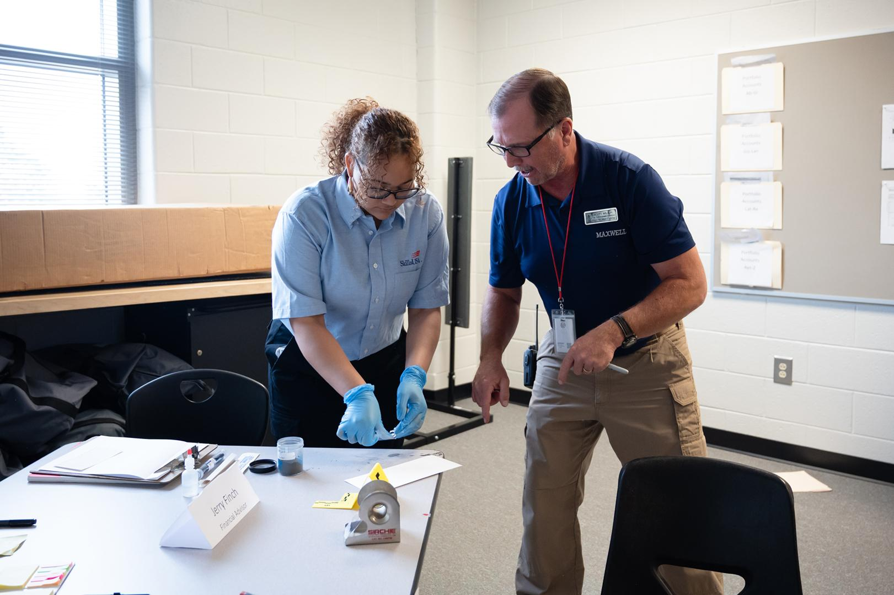


SkillsUSA
Framework
In-person lesson plan
Advisors

Slide 2
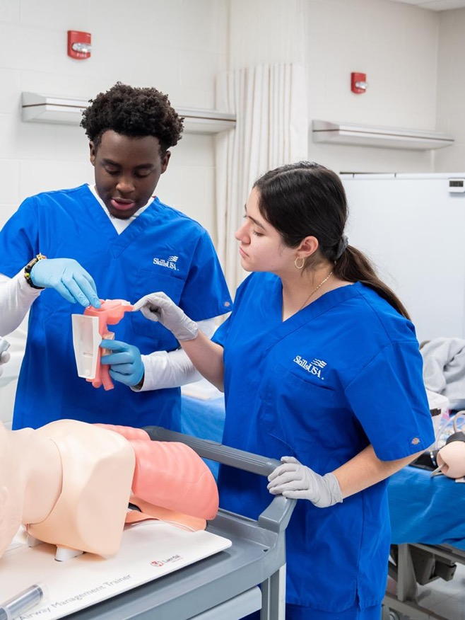

PRE-WORK
Objective:
List the three components of the
SkillsUSA Framework.
Supplies:
2 sticky notes per student
Fillable Framework Graphic
Poster/drawing of Framework with detachable labels for the components
Video: SkillsUSA Framework
Length:
15 minutes

Slide 3

OPENING 5 minutes
Welcome students to the classroom and point out the poster/drawing of the Framework with no labels at the front of the classroom.
Explain that the labels are hidden around the classroom and their goal is to find each label and place it on the Framework. Allow time for students to search around the classroom. Consider playing music during this time.
After the labels have been found and placed on the SkillsUSA Framework, congratulate students on their success and let them know you will be diving deeper into the Framework in the next couple of minutes.
Download the SkillsUSA
Framework here.

Slide 4

CONTENT 8 minutes
Show the SkillsUSA Framework Video
Facilitate a guided discussion.
Reinforce these facts as you facilitate conversation:
• The Framework consists of three components -
personal skills,workplace skills,
and technical skills grounded in academics.
• The components encompass 17 Essential Elements -
skills that industry partners say are important
• It provides a common language for students to describe
how they have grown in career readiness skills.

Slide 5
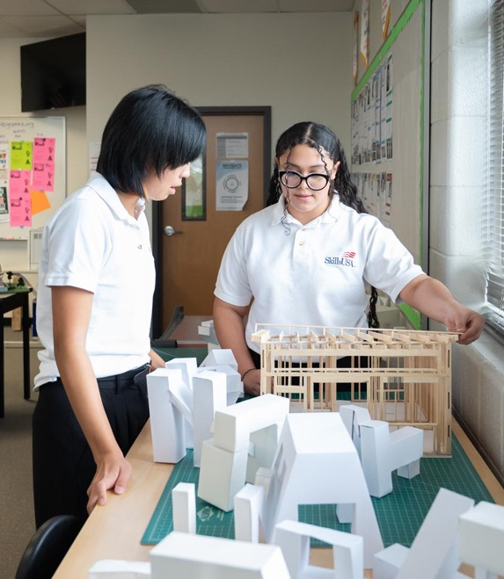
CLOSING 2 minutes
Give each student two sticky notes and instruct them to jot down two questions they still have about the SkillsUSA Framework.
Provide space somewhere in your classroom for a “parking lot.” Once students have written down their questions, have them stick them in the parking lot. Explain that you will answer the questions in the next class.
Consider using the parking lot as a space for students to continue adding any questions they have about SkillsUSA.

