Slide 1
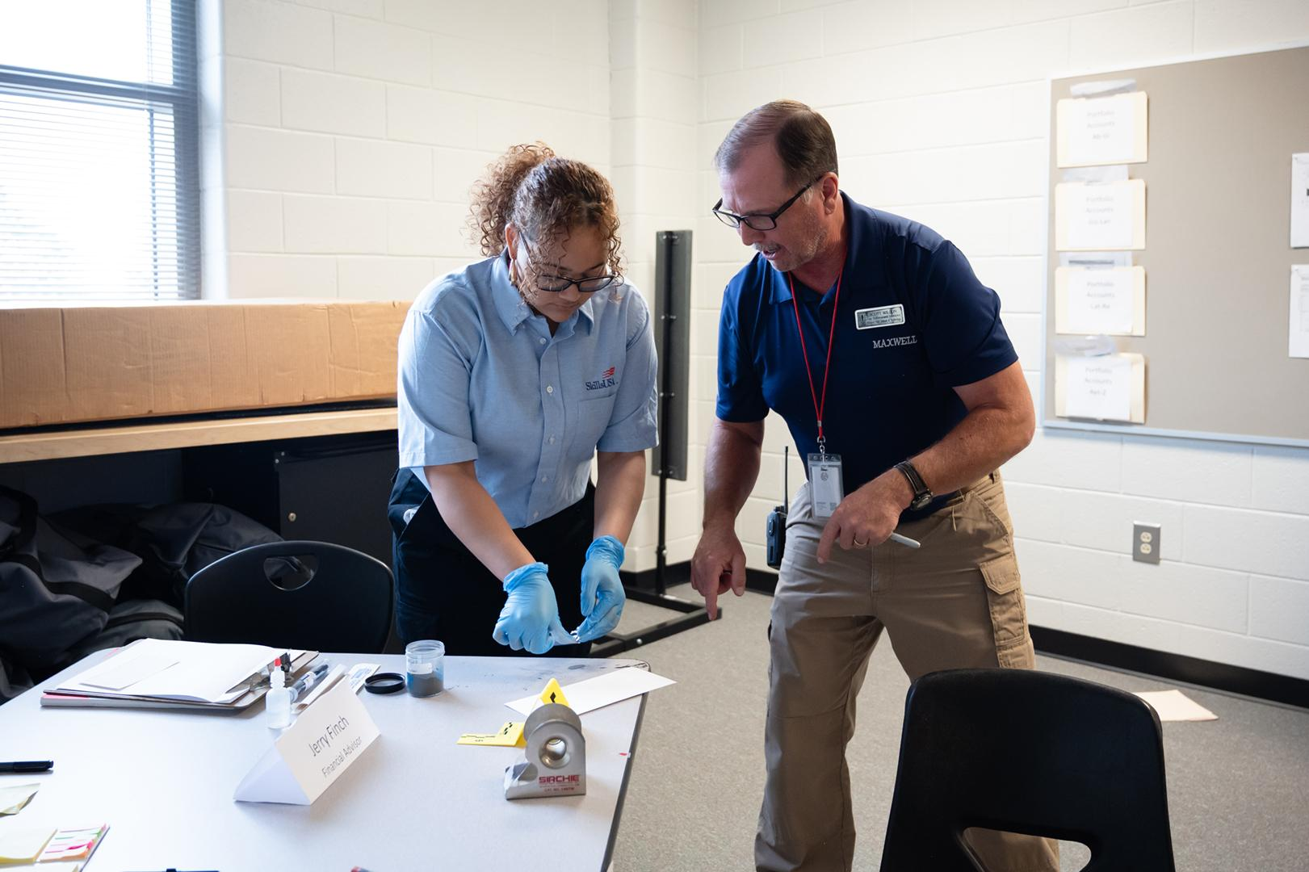
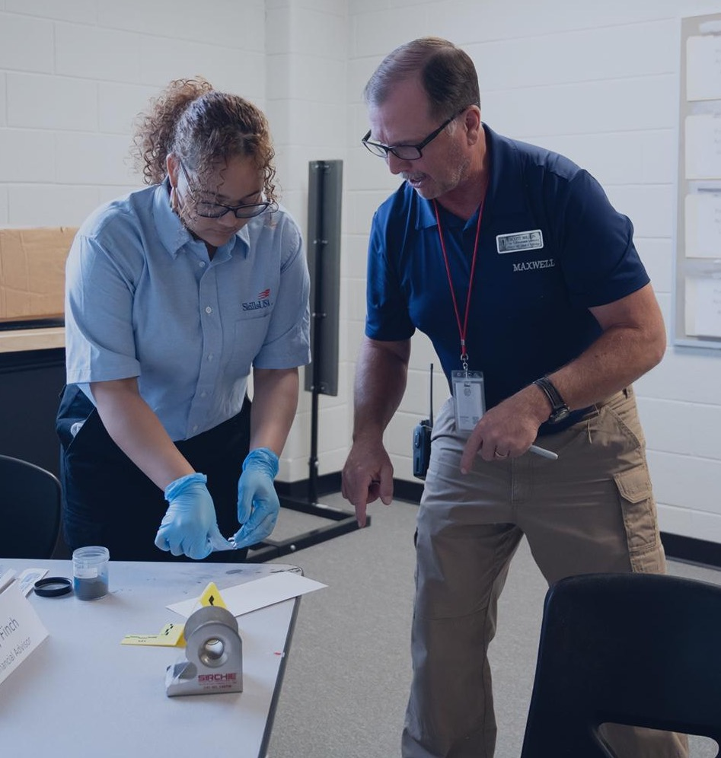

What is
SkillsUSA?
In-person lesson plan
Advisors

Slide 2
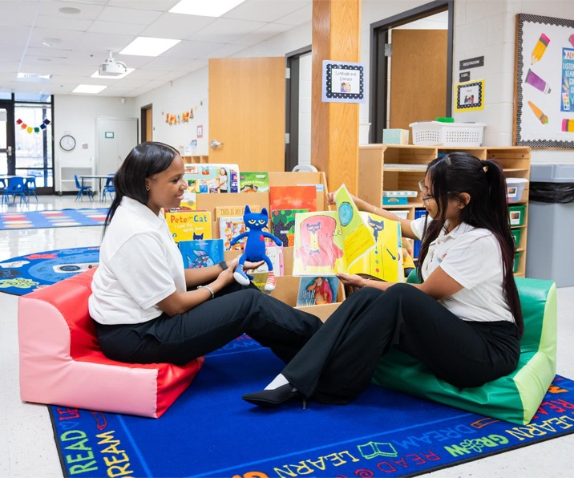

PRE-WORK
Objective:
Identify one aspect of SkillsUSA that interests you.
Supplies:
Video Link: We Are SkillsUSA
Electronic device per student
Website Link: SkillsUSA Website
Length:
15 minutes

Slide 3
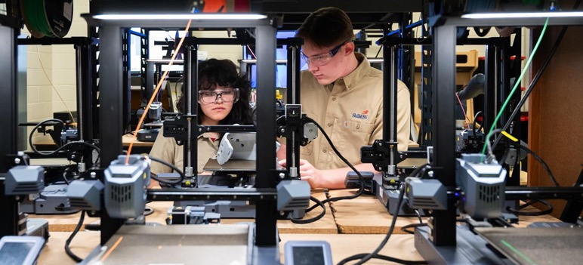
OPENING 3 minutes
Play the We Are SkillsUSA video to introduce SkillsUSA.
Lead a brief discussion about what students observed
from the video. Use these questions as a guide:
• Who has heard of SkillsUSA before?
• What did you learn about SkillsUSA from the video?
• What do you want to learn about SkillsUSA?

Slide 4
CONTENT 8 minutes
Provide a short explanation of SkillsUSA. Make sure to include these points if they weren’t covered in the conversation above:
• SkillsUSA is a partnership between students, teachers,
and industry members.
• It allows students to develop skills that are valued in the workplace.
• SkillsUSA focuses on preparing students for careers in trade, technical and skilled service (including health) occupations.
• SkillsUSA is the #1 workforce development organization for students. We empower students to become skilled professionals, career-ready leaders and responsible community members.
CONTENT CONTINUED
NEXT PAGE

Slide 5
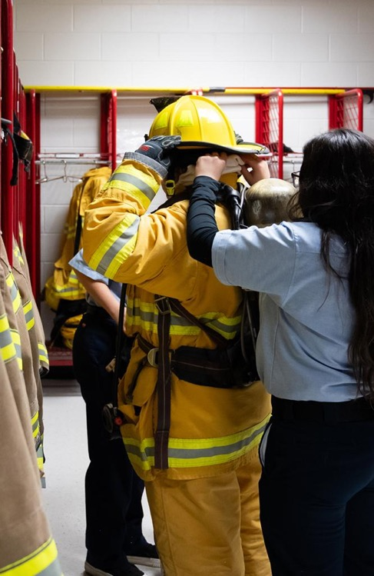
CONTENT 8 minutes
Explain that SkillsUSA provides many different opportunities for students including conferences, interactions with business and industry partners and competitions.
Instruct students to pull out an electronic device and navigate to the SkillsUSA website. Give about seven minutes for students to explore the website - specifically the activities and events SkillsUSA offers.
Instruct them to identify at least one event or program they would like to participate in and why.

Slide 6
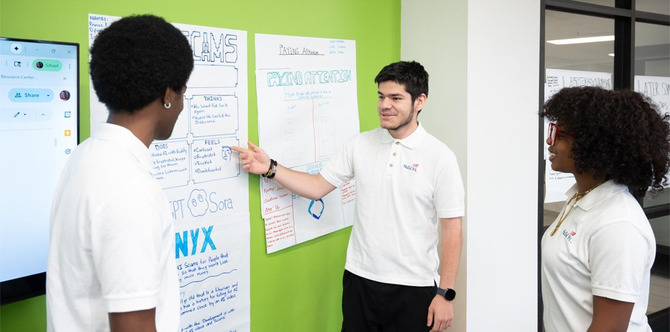
CLOSING 2 minutes
Have students pair up with someone from across the room and share what event or program they would like to participate in and why.
If time allows, elicit a few responses from the group.

