Slide 1
Level Up with SkillsUSA!
[Advisor Name], SkillsUSA
[Chapter Name] Advisor

Slide 2

Click to view the We Are SkillsUSA Video

Slide 3
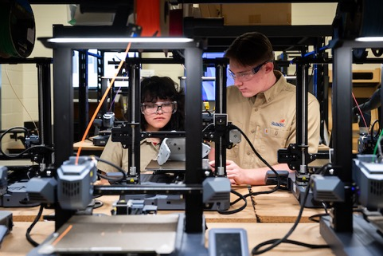
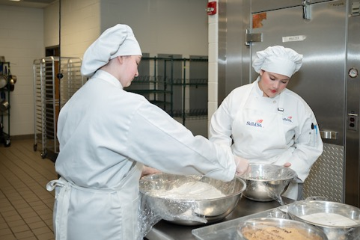
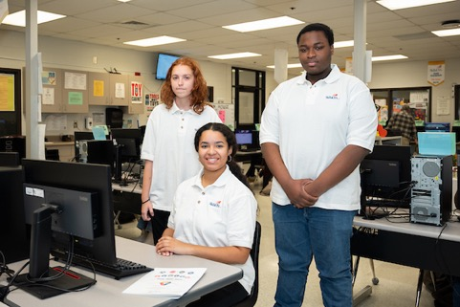
What is SkillsUSA?
A national organization that helps students:
  Build technical, workplace and leadership skills
  Connect with industry leaders and employers
  Compete, lead and prepare for successful careers

Slide 4
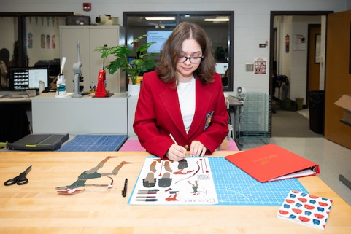
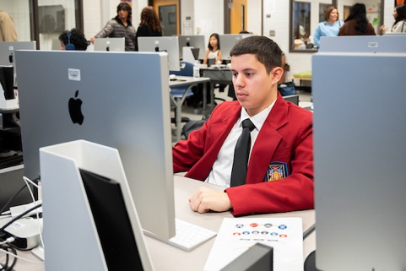
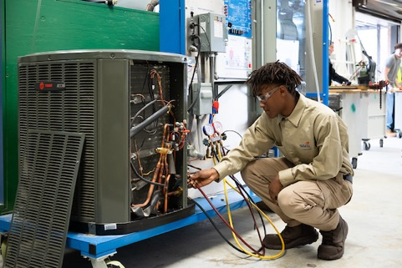
What’s in it for you?
Earn recognition and rewards
Learn real-world skills employers want
Meet people who can help you in your future
Stand out for college, apprenticeships or jobs

Slide 5
What We Do:
Career Competitions:
Test your skills against others learning your careers skills.
Develop Leadership Skills
Become an officer, volunteer or lead projects.
Career Connections:
Meet employers, tour companies, attend events

Slide 6

Career Competitions
Over 100 career competitions—
from robotics to welding to public speaking.

Slide 7

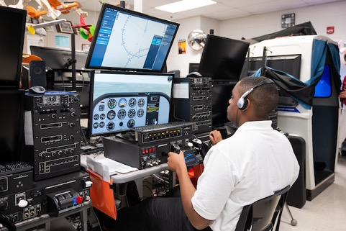
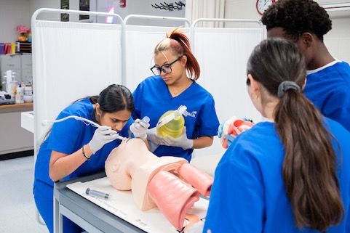
Scholarships and Recognition
SkillsUSA students gain access to:
  Scholarships
  Recognition awards
  Industry certifications employers respect

Slide 8
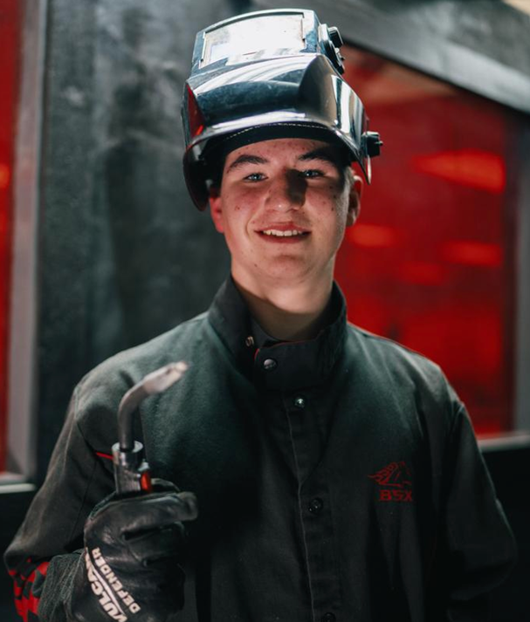
Student Testimonials
“SkillsUSA gave me the confidence to talk to employers and land my first internship, while learning the technical skills I needed in my class.”
— Andy Kane
Alltown High School

Slide 9

Join SkillsUSA!
Getting started is easy:
Talk to [Advisor Name]
Come to our first meeting
[date/time]
Membership fee:
[if applicable]

