Slide 1
Competitor Webinar 2026
Welcome and Introduction of Mechatronics Technical Committee
Floor Plan of Competition
Competition Schedule
Competition Specs
Scoring
Tool List
Q&A

Slide 2

Mechatronics Technical Committee
  Alyssa Russo – Technical Chair
  Kenneth Bibb – Technical Committee Member
  Joshua Whittington – Technical Committee Member
  Brian Burgess - Technical Committee Member
  Chris Stevens - Technical Committee Member
  Corey Adams – Technical Committee Member
  Dylan Shanahan – Technical Committee Member
  Lisa Marshall – Technical Committee Member
  Erika Staackman - Technical Committee Member

Slide 3
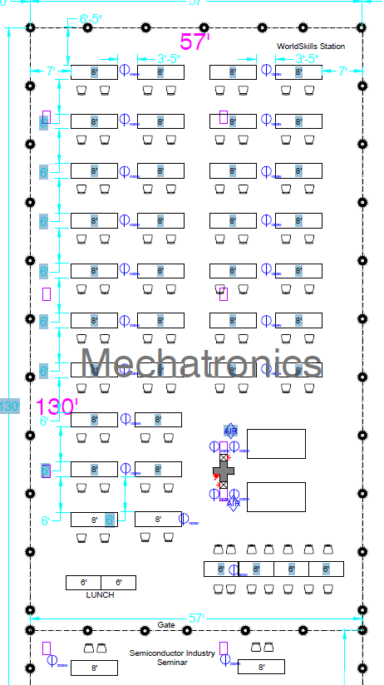
Competition Area, Hall C
1 Project
  Broken down into 4 sections:
    Mechanical and/or Pneumatic Assembly
    Electrical Wiring
    PLC Programming
    Robotic Integration
1 Written Exam
  NC3 Certification Test

Slide 4
Schedules for 2026 NLSC
Competition
 | WEDNESDAY
 | 8:00 – 11:30 |  |  | 11:30 -12:30 | 12:30 - 4:00
Secondary | Meclab Assembly |  |  | LUNCH | Meclab Assembly
 | 8:00 – 11:30 |  |  | 11:30-12:30 | 12:30 – 4:00
Post Secondary | Skills Conveyor Assembly |  |  | LUNCH | Skills Conveyor Assembly
 | THURSDAY
 | 8:00 – 9:00 | 9:00 – 10:00 | 10:00 – 11:00 | 11:00 -12:00 | 12:00 – 4:00
Secondary | Meclab Progamming |  |  | LUNCH | Magician E6 Programming
 | 8:00 – 9:00 | 9:00-11:00 |  | 11:00-12:00 | 12:00 – 4:00
Post Secondary | Skills Conveyor Assembly - App & Program |  |  | LUNCH | UR Programming

Slide 5
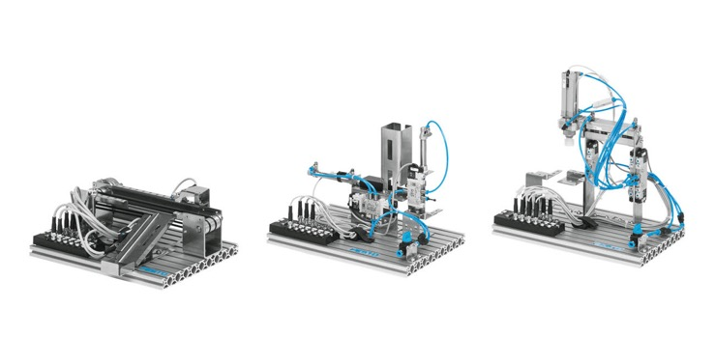
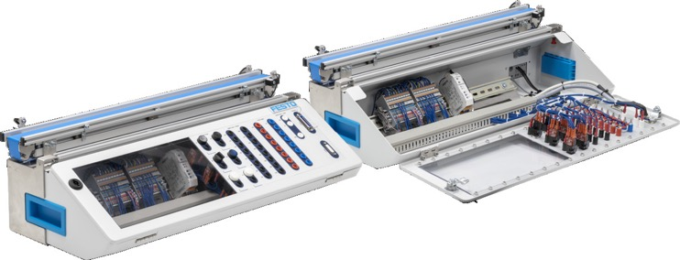
Technical Committee Supplied:
Secondary Competition:
Post-Secondary Competition:
Each competitor will be given the follow:
Day 1: (Assembly Only)
One fully disassembled Meclab Set:
  Mechanical, Electrical, and Pneumatic Drawings
Tubing and Wire Connectors
Day 2: (Programming)
Dobot Magician E6
Two Meclab PLC cables
Each competitor will be given the following:
Day 1: (Assembly Only)
Skills Conveyor Disassembled:
  Mechanical and Electrical Drawings
Day 2: (Programming)
Secondary Application to couple with conveyor
UR 3e Robot

Slide 6
Scoring
Category | Tech Standards/ Specifications | Substantially Demonstrated |  | Moderately Demonstrated |  | Minimally Demonstrated |  | Score (0-5) | Weight | Awarded Points | Total Points
Mech 1.0 | Interpretation of Technical Drawings of Various Types | 5 | 4 | 3 | 2 | 1 | 0
1.1 | Read and Interpret Electrical Schematics | Can read and interpret all drawings | Can read and interpret most drawings provided in all 3 categories | Can read and understand all drawings of at least 2 categories | Can read and understand a few drawings of 2 categories | Can read and understand most drawings in 1 category | Can not read/interpret any style of drawing | 5 | 15 | 75 | 75
1.2 | Read and Interpret Mechanical Drawings
1.3 | Read and Interpret Fluid Power Drawings
Mech 2.0 | Build a Mechatronic Device Upon Given Specifications | 5 | 4 | 3 | 2 | 1 | 0 | Score(0-5) | Weight | Awarded Points | 200
2.1 | Use Measurement Tools | Can use all measurement tools provided |  | Can use most measurement tools provided |  | Can not use measurement tools |  | 5 | 10 | 50
2.2 | Select Fasteners to mount Components | Understands proper component and hardware usage. The system is set-up neatly and efficiently, no loose wires, tubing, or components |  | Has some understanding of proper component and hardware usage. The system is set-up semi-neatly, there may be some unattached components and/or loose wires/tubing |  | Does not have an adequate understanding of proper component and hardware usage. The station is laid out messily, tubing not tied down, wires strewn, components left unattached. |  | 5 | 10 | 50
2.3 | Use Appropriate Wires to Make correct Electrical Connections
2.4 | Use Appropriate Tubing to make Pneumatic Connections
2.5 | Employ best practices in laying out wires and tubes for neatness, security, and safe operation
2.6 | Adjust and calibrate subsystems using interdisciplinary skills | Properly calibrates and makes adjustment where needed on the system. Ex: Flow control valve air flow |  | Calibrates most components on station, might have some that have too high psi or other factors. |  | Does not adequately calibrate the station, may only adjust less than 2 components |  | 5 | 10 | 50
2.7 | Employ proper safety equipment and practice | All safety procedures are followed i.e safety glasses, hair tied back, etc. |  | Some safety procedures followed (warnings to be given, if not) |  | Minimal Safety Procedures followed (did not correct after warning) |  | 5 | 10 | 50
Mech 3.0 | Identify and troubleshoot competition modified mechanical, pneumatic, electrical, and electronic components | 5 | 4 | 3 | 2 | 1 | 0 | Score(0-5) | Weight | Awarded Points | 175
3.1 | Use resistance, voltage, and current to test electrical equipment properly | Measurements taken are correct with +/- 5% deviation |  | Measurements are taken correctly within +/- 10% standard deviation |  | Measurements are taken incorrectly, deviation greater than +/- 10% |  | 5 | 10 | 50
3.2 | Install, Service, Adjust, and Troubleshoot Pneumatic and/or Hydraulic Systems | Components are properly installed and running with no issues; all faults properly defined | Components are properly installed and running with no issues; some faults properly defined | Most Components are properly installed and running with no issues; all faults properly defined | Most Components are properly installed and running with no issues; most faults properly defined | Some Components are properly installed and running with no issues; most faults properly defined | Almost no components are properly installed; Almost no faults properly defined. | 5 | 10 | 50
3.3 | Install, adjust, and troubleshoot electro-pneumatic and/or electro-hydraulic systems.
3.4 | Given different components, identify component faults and determine if repair or replacement is needed. | Properly determined each faulted component |  | Most component faults found/ determined the cause |  | No component faults detected |  | 5 | 15 | 75

Slide 7
Tool List/ Competitor Supplied Materials:
Teams competing will be required to write a PLC program. This necessitates each team to provide its own PLC assembly and programming device/software (e.g., laptop computers or hand-held programming devices).
  Two (2) Laptop computers. A minimum of 1 PC should contain the programming software necessary for their PLC assembly. This PC will need the following requirements:
    Ability to connect to their PLC prior to the competition start i.e. through a preconfigure Static IP address that is within the same network range as their PLC ip address (Please confirm this connection prior to sending the PLC and PC to competition, our onsite techs will be unable to troubleshoot PCs that have locked down IT administrative privileges.)
    Ability to connect to the internet for completion of the online written exam, administrated by NC3. Completion of this test with a score of 70% or higher will grant the students with a NC3 Certificate of Knowledge in Mechatronics.
  One (1) PLC assembly. The PLC assembly must meet the following requirements: (preferred bare unwired i/o plcs)
    Power supply: The PLC must be capable of operation at 24VDC, or 120VAC - rated for 5 Amps. All 120VAC units must be wired ahead of time to an in-line ground-fault interrupter device and standard (NEMA 5-15P) 120VAC line cord. All 120VAC wiring must meet PLC manufacturer’s requirements and follow standard industry practice. Judges reserve the right to disallow the use of any competitor-supplied equipment that presents a safety hazard. No line cords or 120VAC wiring devices will be supplied at the competition.
    PLC shall have a minimum of 16 digital inputs and 16 digital outputs.
    Inputs shall be 24VDC Sinking (inputs shall be activated by application of a +24VDC signal to the input terminal).
    Outputs shall be 24VDC Sourcing (outputs shall supply a +24VDC signal to the load when activated). All loads will be returned to ground. Output capacity shall be no less than 0.5A, each.
Basic hand tools should include the following: Various Pliers (needle nose pliers, snap ring pliers), Ferrule Crimps, wire cutters, wire strippers, hex keys (metric and imperial), screw drivers, Wrench set (6mm to 10mm), Digital multimeter.

Slide 8
What not to bring (i.e. “Banned” materials list”)
  The technical committee will provide terminal blocks and wire, so the following does not need to be brought:
  Ferrules, Spade Connectors, Terminal Rings (all needed electrical connectors are supplied by technical committee)
  Wire
  No Pocket knives, box cutters, nothing with an open blade (tubing cutters will be provided)
  No Hammers, mallets, etc. needed.
  Unprofessional or Self-made Tools
  Secondary only: No external 15-pin PLC cables to connect to the system.

Slide 9
Secondary only:
Preparing to use the Dobot Magician E6:
For all competitors, please have Dobot Studio Pro installed on one PC to program your assigned robot. (Version needed: 4.6) – The files can be downloaded from this link: Download Here!
    Password for download file: Festo123
    The manual can be downloaded from the user portal on Dobot-robots.com in which your advisor can make a user account to access all resources
Good General Robotic Knowledge needed:
Make sure you know how to change the IP address to static IP to connect to their robot
Have a basic understanding of different types of movement (joint and linear)going over some basics of singularities, differences between joint and linear moves.
Handshake techniques between PLC and Robotic Arm.

Slide 10
Post-Secondary only:
Preparing to use a UR3e
A robotic integration portion is being included in the afternoon session of Day 2 upon completion of the assembly and programming of their station. This robot will be provided by Universal Robots and to allow for preparation, here is a link to their eLearning for the system. To log-in, create a free profile and then, select education/student to access:
https://academy.universal-robots.com/free-e-learning/ (8 hrs of free content to cover everything) –
Recommendation:The core track and pro track

Slide 11
Thank you!
We look forward to seeing everyone in Atlanta!
Questions and Answers
Please use the chat to ask your questions!

