Slide 1
Leadership
Development
Grow with

Slide 2

Who do you admire as a leader?

Slide 3

What positive behaviors do leaders demonstrate?

Slide 4
Merriam Webster Dictionary
Leadership (noun)
1. the office or position of a leader
• recently assumed the leadership of the company
2. capacity to lead
• a politician who lacks leadership
3. the act or an instance of leading
• leadership molds individuals into a team

Slide 5
Cambridge Dictionary
Leadership (noun)
1. the set of characteristics that make a good leader
• He lacks leadership qualities/skills.
2. the position or fact of being the leader
• The group flourished under her firm leadership.
3. the person or people in charge of an organization
• There is growing discontent with the leadership.

Slide 6
John Maxwell
Author and Orator
“Leadership is influence. It is the ability to obtain followers…A leader is great not because of his power, but because of his ability to empower others.”

Slide 7
Lisa Cash Hanson,
Entrepreneur, Speaker and Inventor
“Leadership is the ability to guide others without force into a direction or decision that leaves them still feeling empowered and accomplished.”

Slide 8

How do you define leadership?

Slide 9
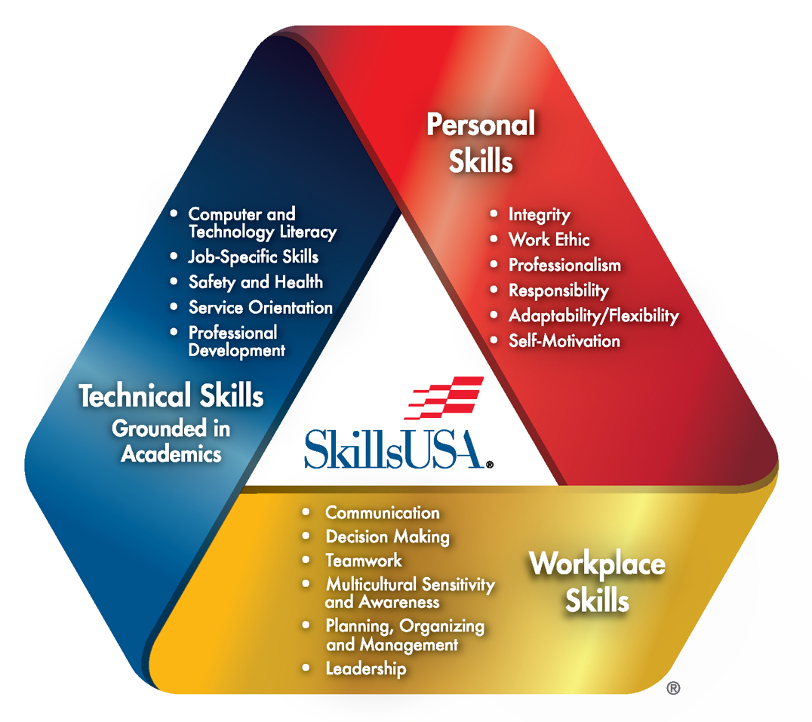

Slide 10
The SkillsUSA Framework Essential Element of Leadership is defined as:
Build and model trust
Foster hope
Express compassion
Establish stability

Slide 11

When have you demonstrated leadership?

Slide 12
Share

Slide 13

What challenges have you faced, or might face, as a leader?

Slide 14
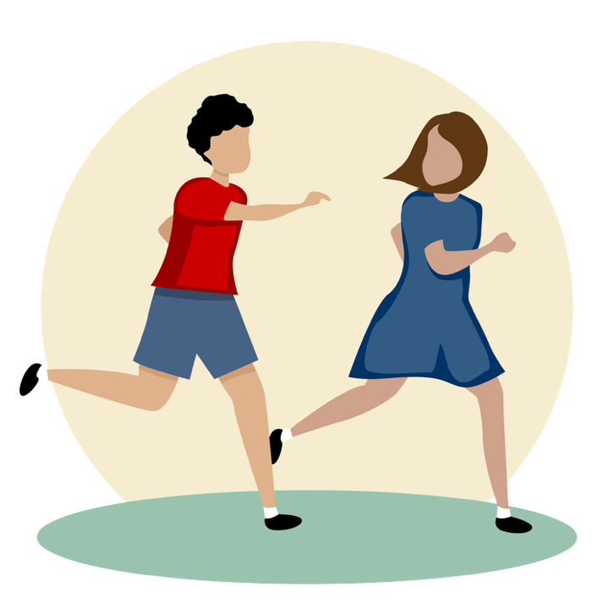
Blob Tag

Slide 15
What is ONE ACTION you can take today to help grow your leadership skills?

Slide 16
Why do these actions matter?

Slide 17
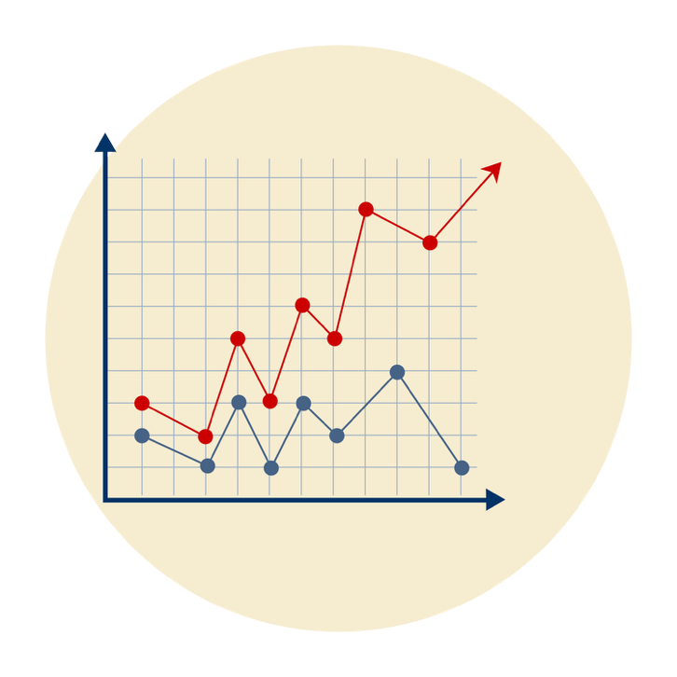
How will taking these actions help you grow your leadership skills?

