Slide 1
Competitions
Thrive Through

Slide 2
New Year Resolution

Slide 3





Slide 4

Identify benefits of competition and list SkillsUSA competitions.

Slide 5

Round 1: Fastest Airplane
5-minute time limit

Slide 6

Round 2: Furthest Flight
5-minute time limit

Slide 7

Round 3: Team Flight
5-minute time limit
You may not physically touch the paper airplane to move it.

Slide 8
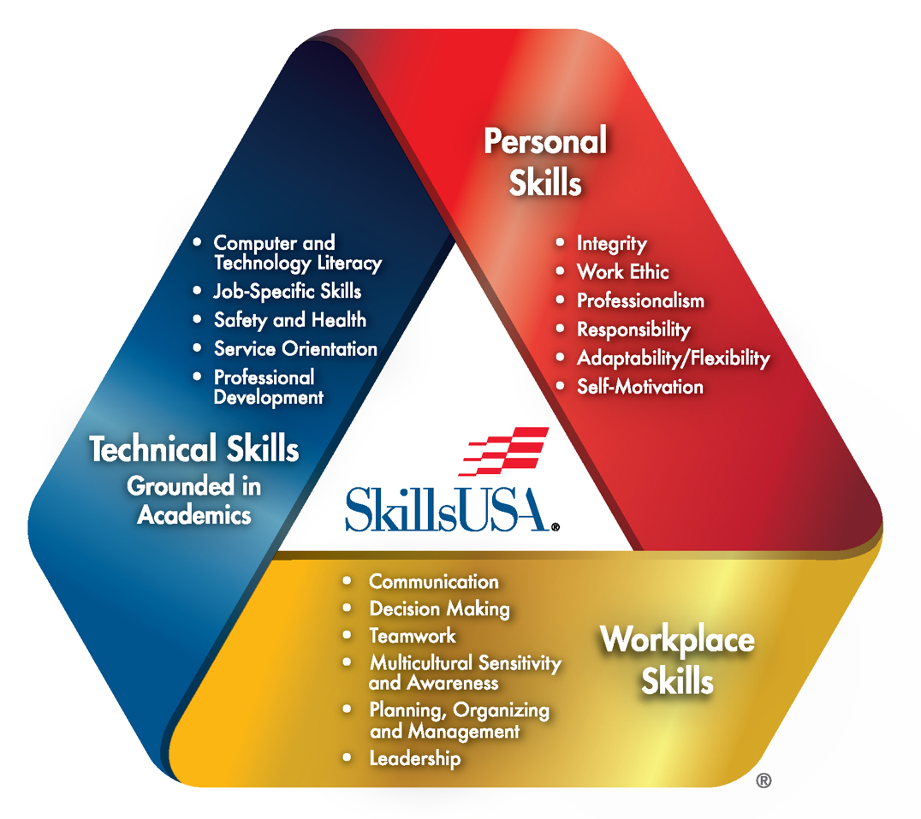

Slide 9

Watch the SkillsUSA Championships Video.

Slide 10
SkillsUSA Championships Category: LEADERSHIP
Action Skills
American Spirit
Chapter Display
Community Action Project
Community Service
Extemporaneous Speaking
Job Interview
Job Skill Demonstration A
Job Skills Demonstration Open
Opening and Closing Ceremonies
Outstanding Chapter
Pin Design
Prepared Speech
Promotional Bulletin Board
Quiz Bowl
T-Shirt Design

Slide 11
SkillsUSA Championships Category: OCCUPATIONAL
Engineering Technology - Design

Slide 12
SkillsUSA Championships Category: SKILLED TECHNICAL
3D Visualization and Animation
Additive Manufacturing
Commercial sUAS Drone
Interactive Application and Video Game Development
Mobile Robotics Technology
Robotics – Urban Search and Rescue
Team Engineering Challenge

Slide 13

SkillsUSA Competition Resolution
This year I will…

