Slide 1
Advocacy and Marketing
Promote Through

Slide 2
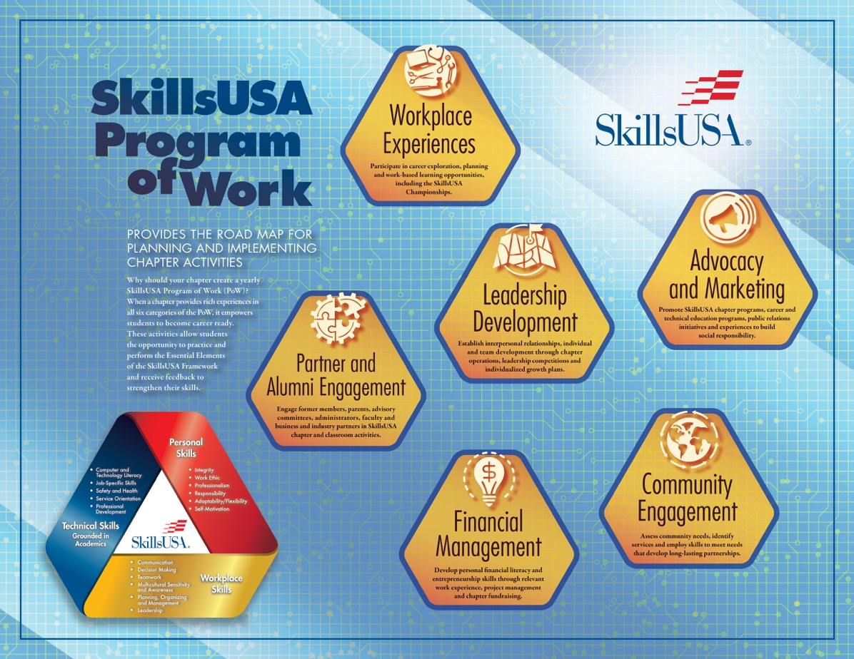

Slide 6
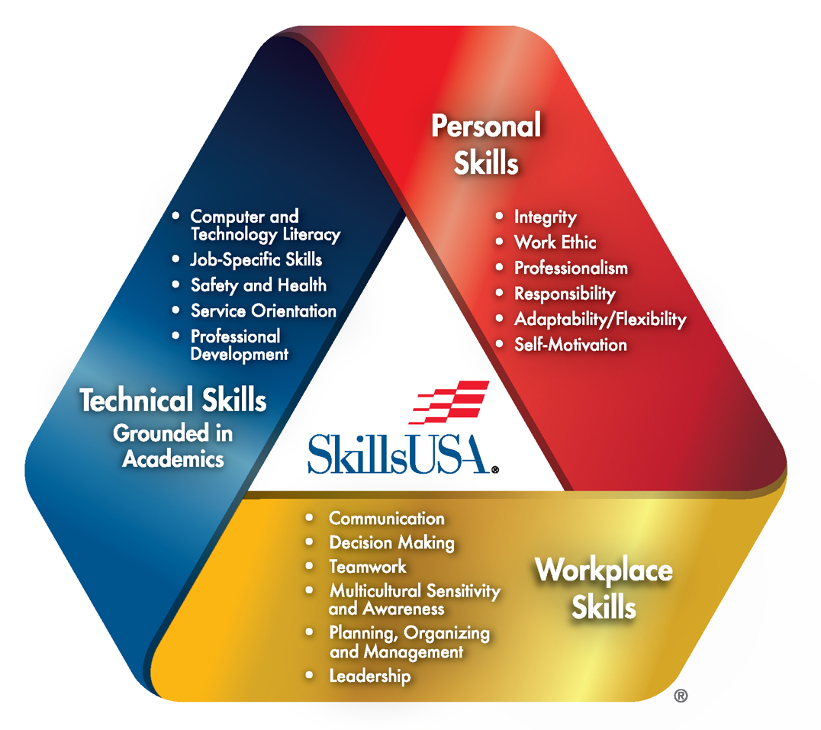

Slide 7

Brainstorm
20 words to describe the brand, culture or work of SkillsUSA

Slide 8

What are the strengths of our SkillsUSA Chapter?

Slide 9

Digital Marketing
Websites
Blogs
Social Media content
Email campaigns
Digital ads on the web
Videos
Infographics
Presentations

Slide 10
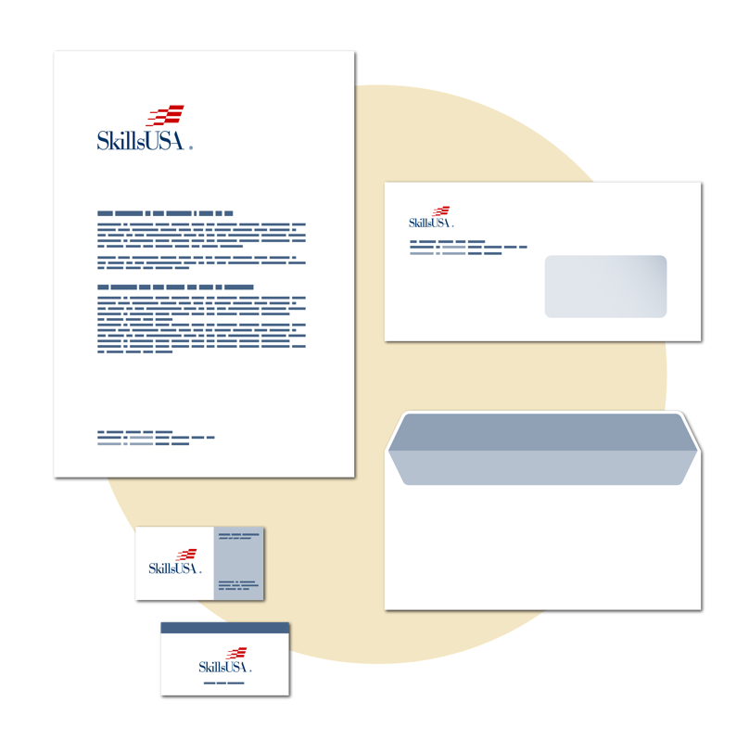
Print Marketing
Business cards
Stationary
Brochures and flyers
Posters
Billboards
Direct mail including postcards
Print ads in newspapers or magazines

Slide 11

Content Marketing
Booklets
Case studies
Testimonials
Blog posts
Podcasts

Slide 12
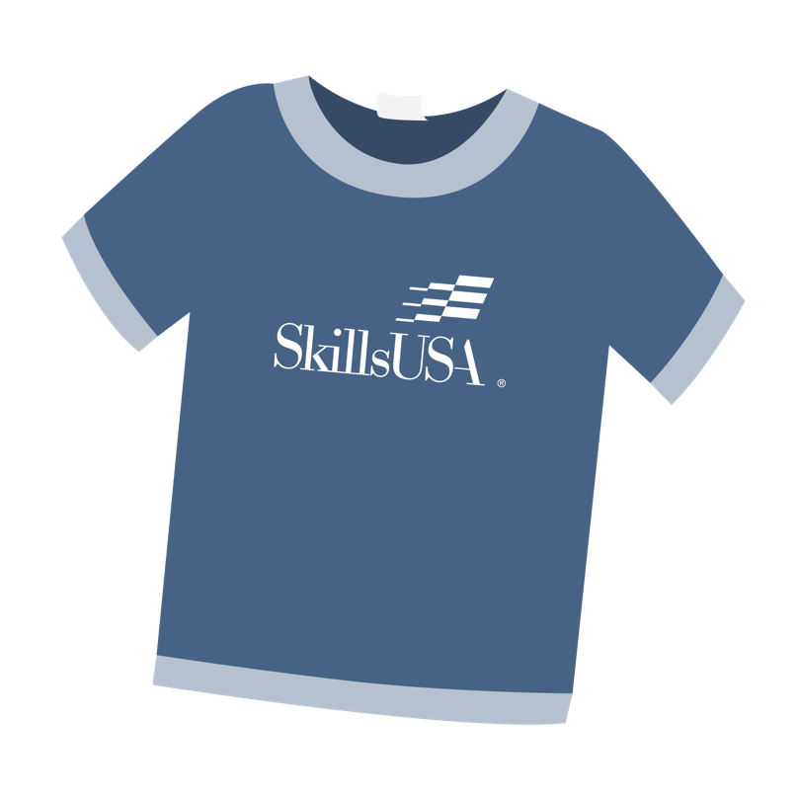
Other Assets
Merchandise and swag
Booths, banners, displays

Slide 13

Create a Marketing Asset to PROMOTE SkillsUSA
Remember the target audience
Identify which asset type will best share that message
Design a marketing asset

Slide 14

Share your Marketing Assets
Identify one or two strengths of each asset
Provide one “what if” improvement suggestion.

Slide 15
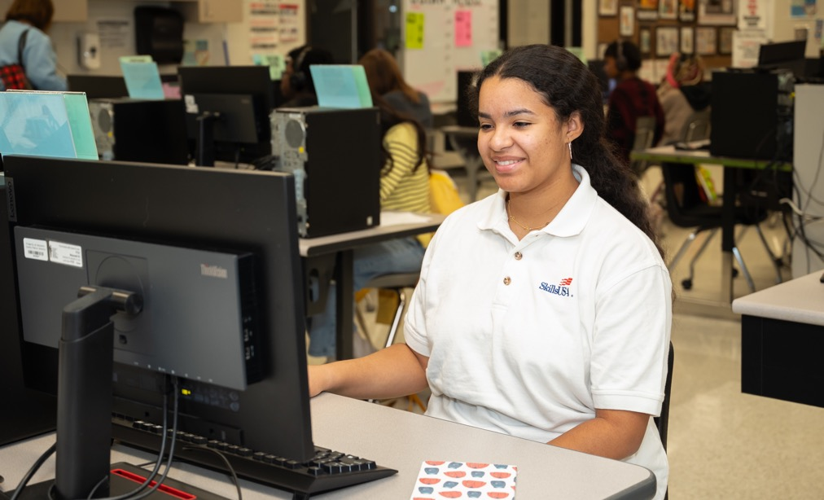
Why is it important for us to positively promote SkillsUSA?

Slide 16

What challenges do we need to overcome when marketing SkillsUSA?

Slide 17

10 Key Points from Today

