Slide 1
Financial Management
Mobilize

Slide 3
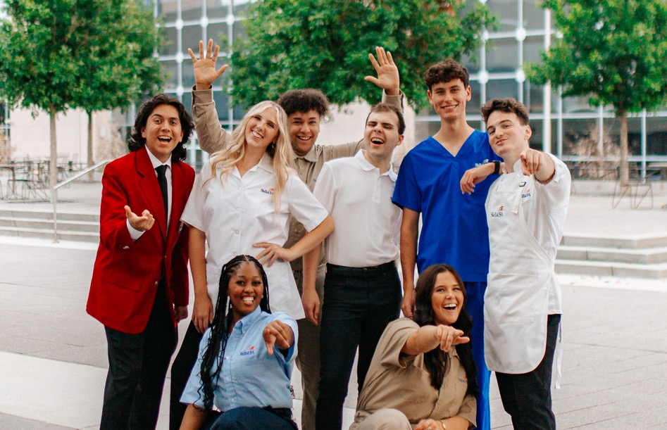
Community
Unified body of individuals such as the people with common interests living in a particular area.

Slide 4
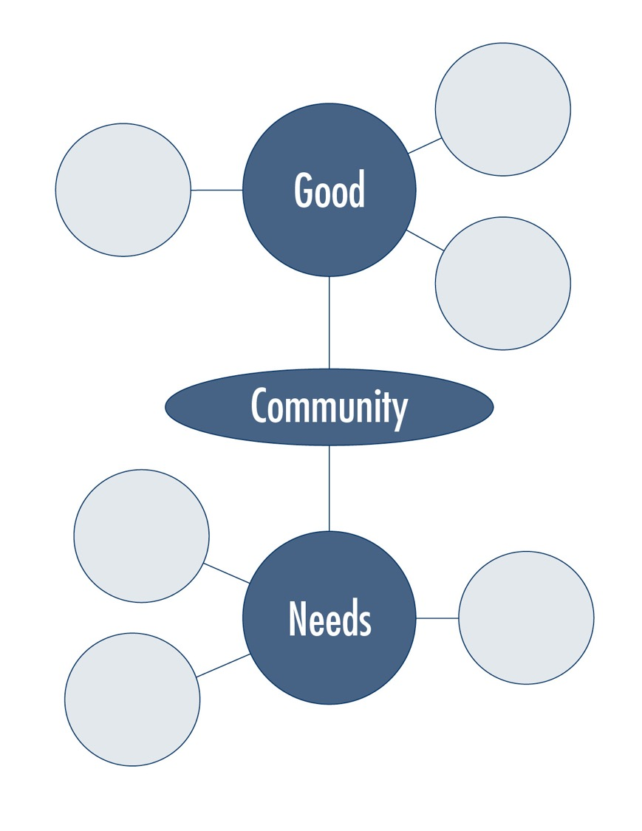

Slide 5
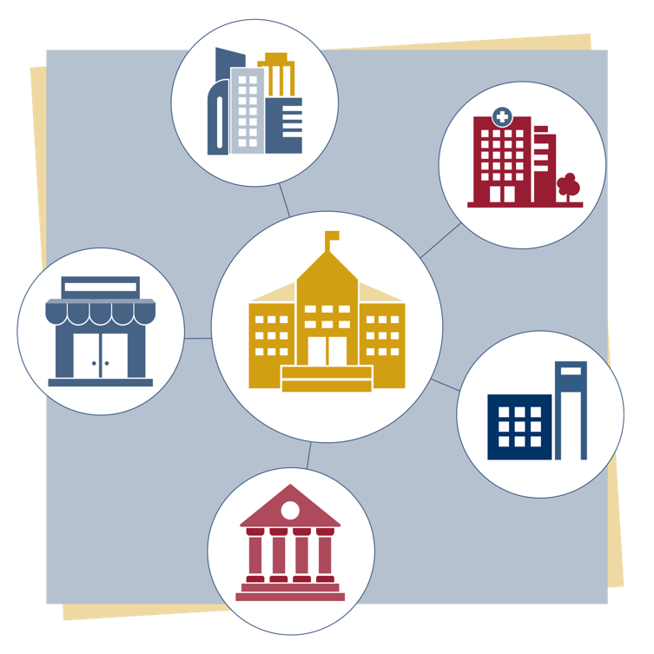
What would it be like to build a community from scratch?

Slide 6

Dream Community
What would you like to see the community look like in 10 years?

Slide 7
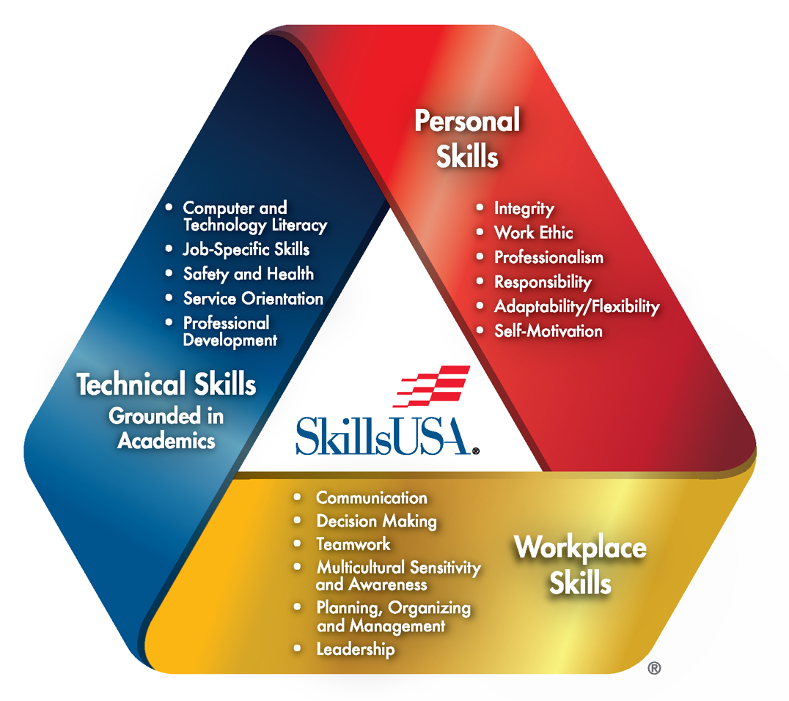

Slide 8

Community Service Projects
Brainstorm Ideas

Slide 9

Service Charades
Share one way you will serve the community this year.
Perform one action to go with the way you will serve.

