Slide 1
Financial Management
Mobilize

Slide 3

What is the cost?

Slide 4
CHAPTER FUNDING

Slide 5
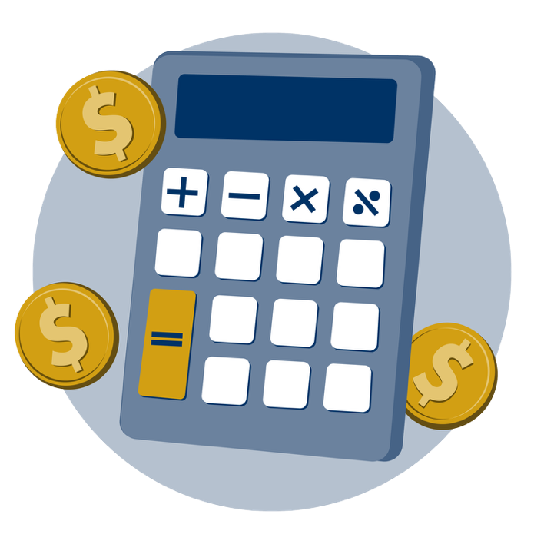
Financial Management
Work efficiently and effectively within a budget
Manage personal (or chapter) finances effectively
Manage resources efficiently

Slide 6

How quick can you finish?

Slide 7
CHAPTER FUNDRAISER

Slide 8

Chapter Fundraiser Goals
Write one personal goal.

Slide 9

Chapter Fundraiser Goals
Share with a partner.

Slide 10
BLOB TAG

Slide 11


Slide 12

3-2-1 Summary

