Slide 1
Chapter Excellence Program
Be a Quality Chapter:

Slide 2
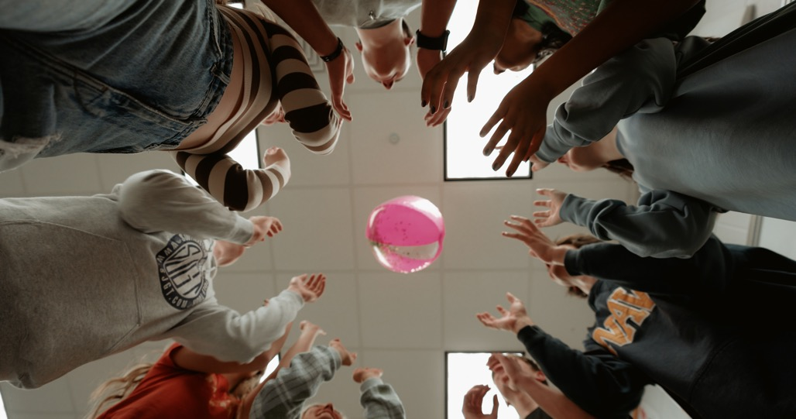
When have you failed to work cooperatively with others?
Select one word to summarize or describe that experience.

Slide 3

Turn over the tarp
Do not step off the tarp.
Everyone must always maintain contact with the tarp.

Slide 4
Celebrate!

Slide 5
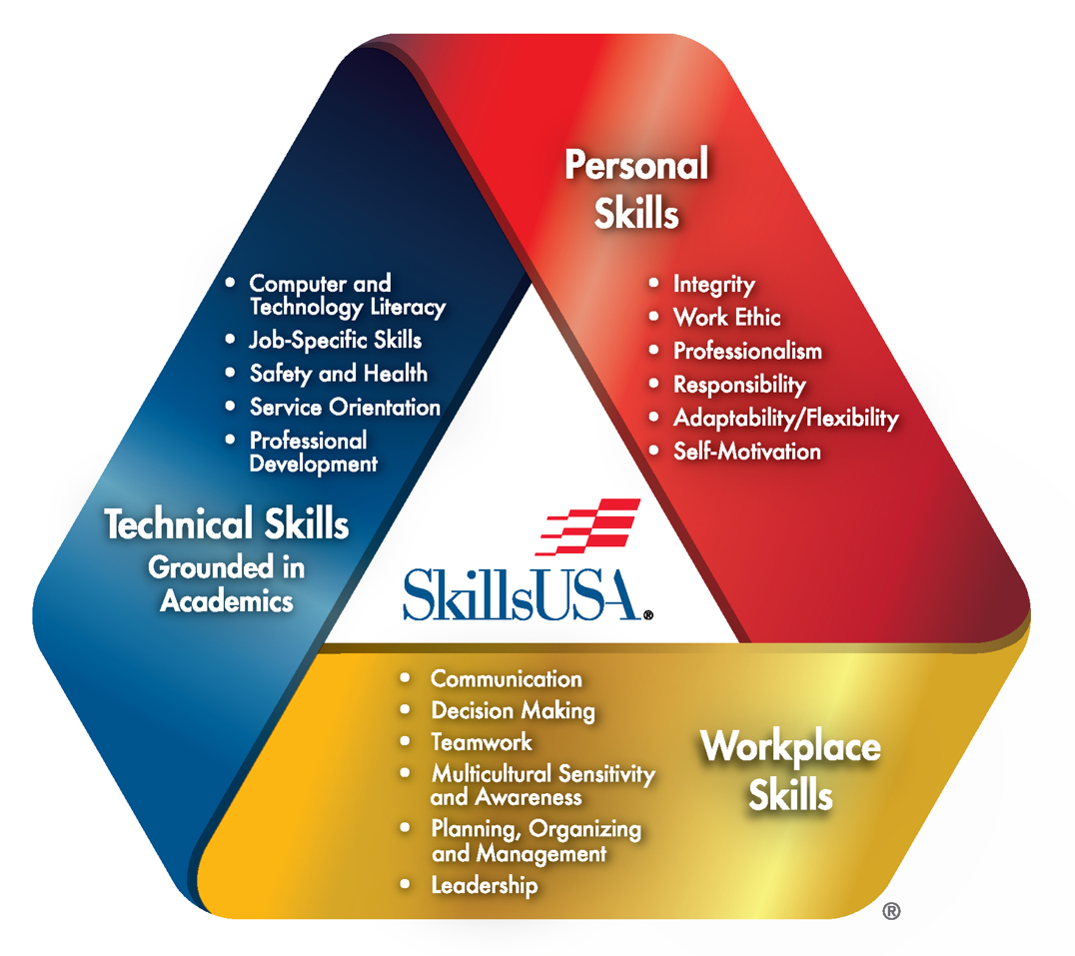

Slide 6
National SkillsUSA
State SkillsUSA Association
Our Local Chapter

Slide 7
Chapter Officers

Slide 8
Chapter Committees

Slide 9

What is your role in SkillsUSA?

Slide 10
Level 3: Models of Excellence
Level 2: Chapter of Distinction
Level 1: Quality Chapter

Slide 11

Chapter Excellence Program
Requirements I play a role in.
Requirements I’m not part of

Slide 12
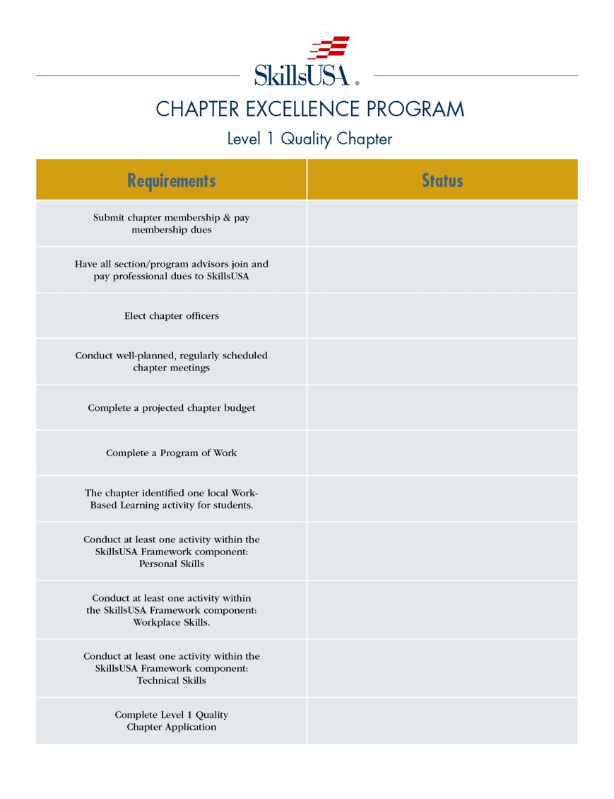

Slide 13
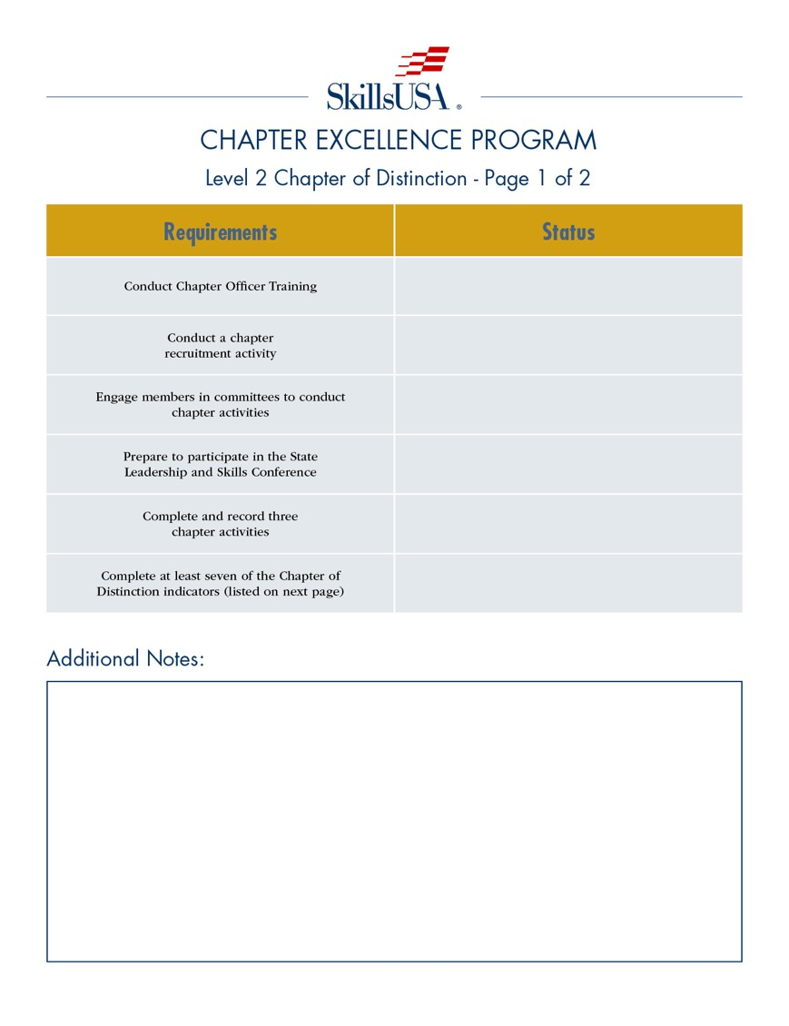

Slide 14
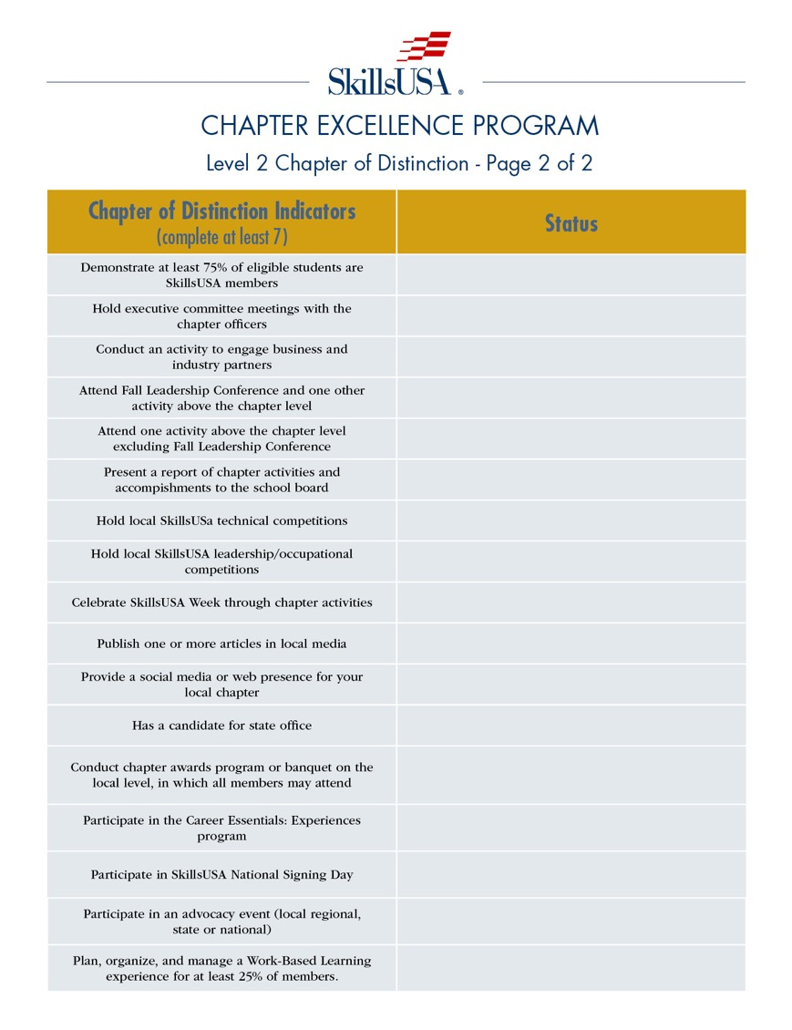

Slide 15
What excites you about CEP?
What does CEP success sound like?
What does CEP success feel like?
What will be most challenging about CEP?

