Slide 1

“What is SkillsUSA?”
SCAVENGER HUNT PRINTOUTS
Print each of these sheets and hide them around the room for a scavenger hunt.

Slide 2

SkillsUSA Defined
SkillsUSA is the #1 workforce development organization for students. SkillsUSA is found in middle schools, high schools and college/postsecondary institutions nationwide.
SkillsUSA students hone their hands-on skills against current industry standards in more than 130 occupational areas, from 3-D Animation to Welding and nearly everything in between. SkillsUSA is a vital solution to the skills gap, where more skilled jobs are available than skilled professionals ready to fill them.

Slide 3

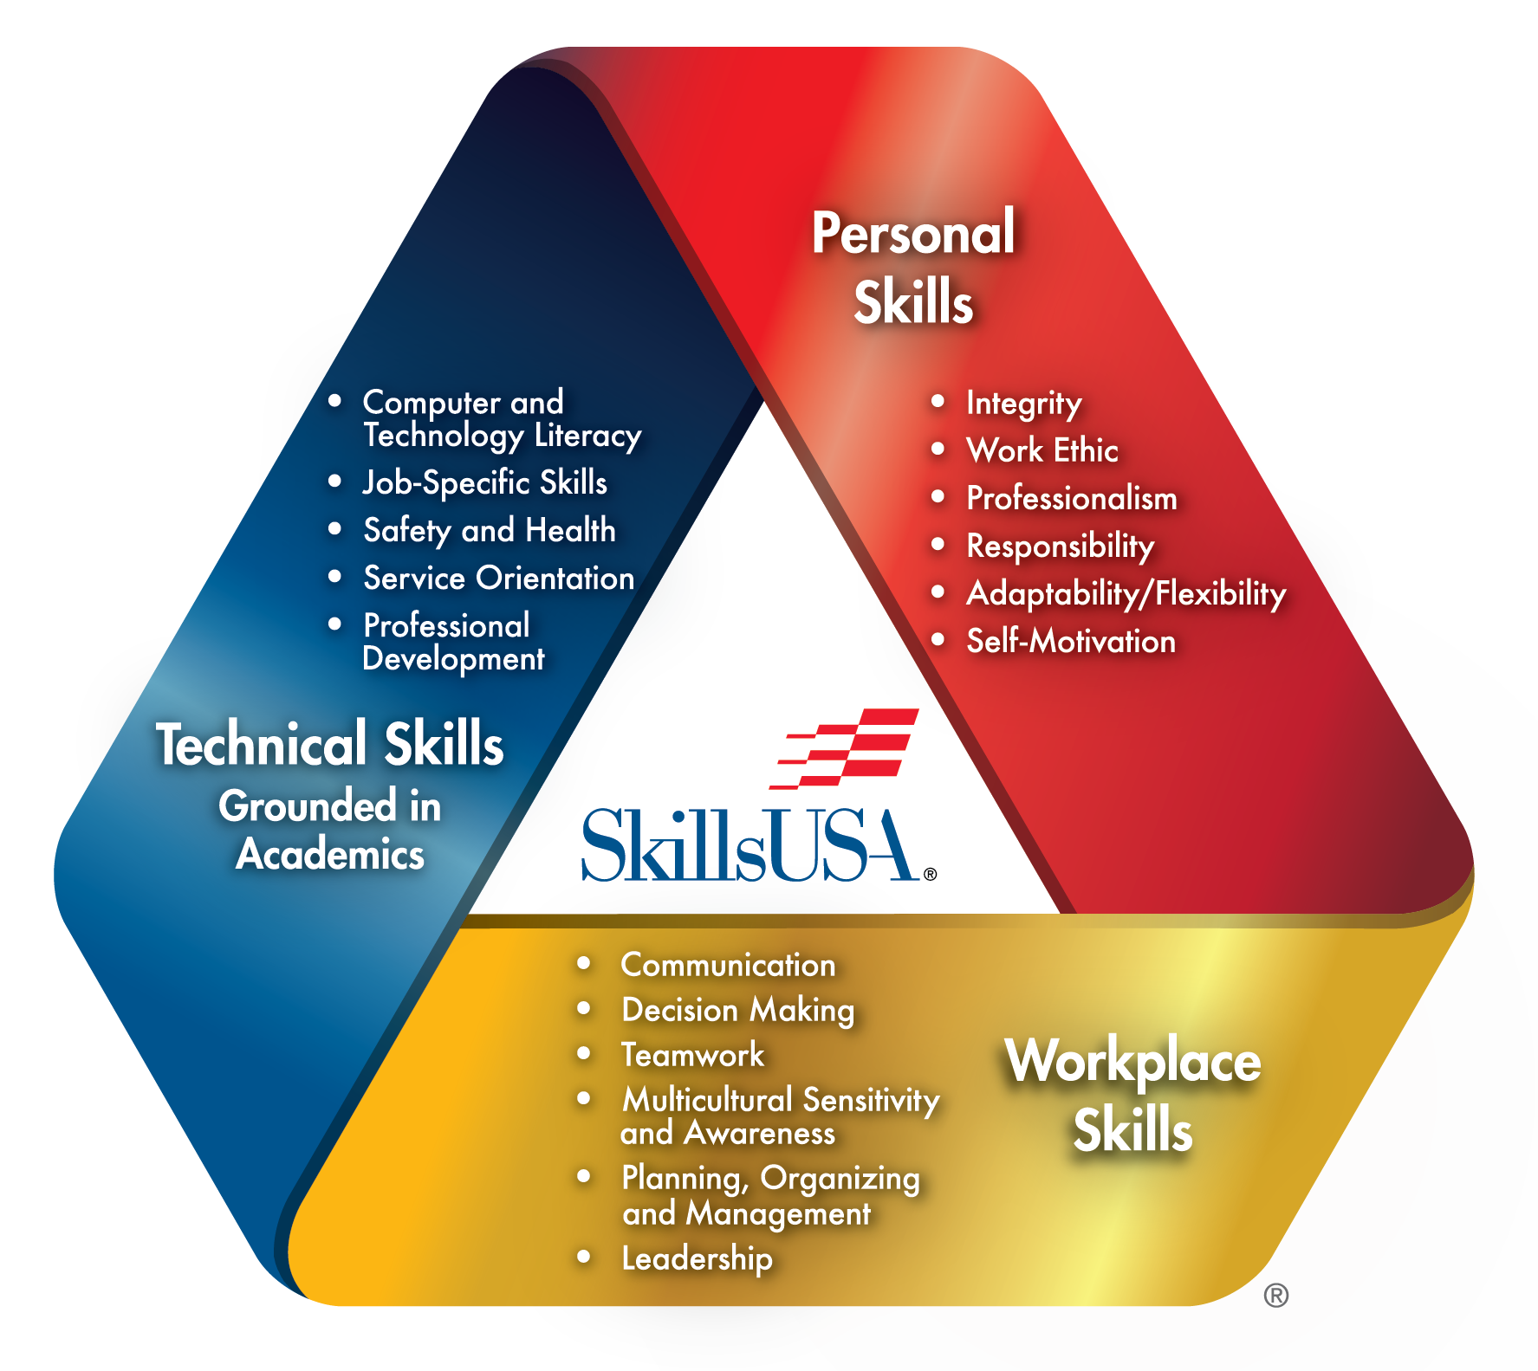
SkillsUSA
Framework
The SkillsUSA Framework is a guide that helps students learn skills in three areas: Personal Skills, Workplace Skills, and Technical Skills Grounded in Academics.
Each of the three components have certain skills, called Essential Elements, that help students become career ready.

Slide 4
SkillsUSA Mission
SkillsUSA is America’s proud champion of the skilled trades. Our mission is to empower students to become skilled professionals, career-ready leaders and responsible community members.

Slide 5

SkillsUSA
Emblem
There are five main parts of the SkillsUSA Emblem, and each
one represents something!
The shield represents patriotism.
The gear represents the industrial society.
The torch represents knowledge.
The orbital circles represent technology.
The hands represent the individual.

Slide 6

SkillsUSA Colors #1 and #2
Red and white represent the individual states and chapters.

Slide 7
SkillsUSA Color #3
Blue represents the common union of the states and of the chapters.

Slide 8

SkillsUSA Color #4
Gold represents the individual, the most important element of the organization.

Slide 9
SkillsUSA Pledge
Upon my honor, I pledge:
To prepare myself by diligent study and ardent practice to become a worker whose services will be recognized as honorable by my employer and fellow workers.
To base my expectations of reward upon the solid foundation of service.
To honor and respect my vocation in such a way as to bring repute to myself.
And further, to spare no effort in upholding the ideals of SkillsUSA.

Slide 10
SkillsUSA Creed
I believe in the dignity of work
  I hold that society has advanced to its present culture through the use of the worker's hands and mind. I will maintain a feeling of humble-ness for the knowledge and skills that
  I receive from professionals, and I will conduct myself with dignity in the work I do.
I believe in the American way of life
I know our culture is the result of freedom
of action and opportunities won by the founders of our American republic, and
I will uphold their ideals.
I believe in education
I will endeavor to make the best use of knowledge, skills and experience that I will learn in order that I may be a better worker in my chosen occupation and a better citizen in my community. To this end, I will continue my learning now and in the future.
I believe in fair play
I will, through honesty and fair play, respect the rights of others. I will always conduct myself in the manner of the best professionals in my occupation and treat those with whom I work as I would like
to be treated.
I believe satisfaction is achieved
by good work
I feel that compensation and personal satisfaction received for my work and services will be in proportion to my creative and productive ability.
I believe in high moral and
spiritual standards
I will endeavor to conduct myself in
such a manner as to set an example for others by living a wholesome life and
by fulfilling my responsibilities as a
citizen of my community.

Slide 11
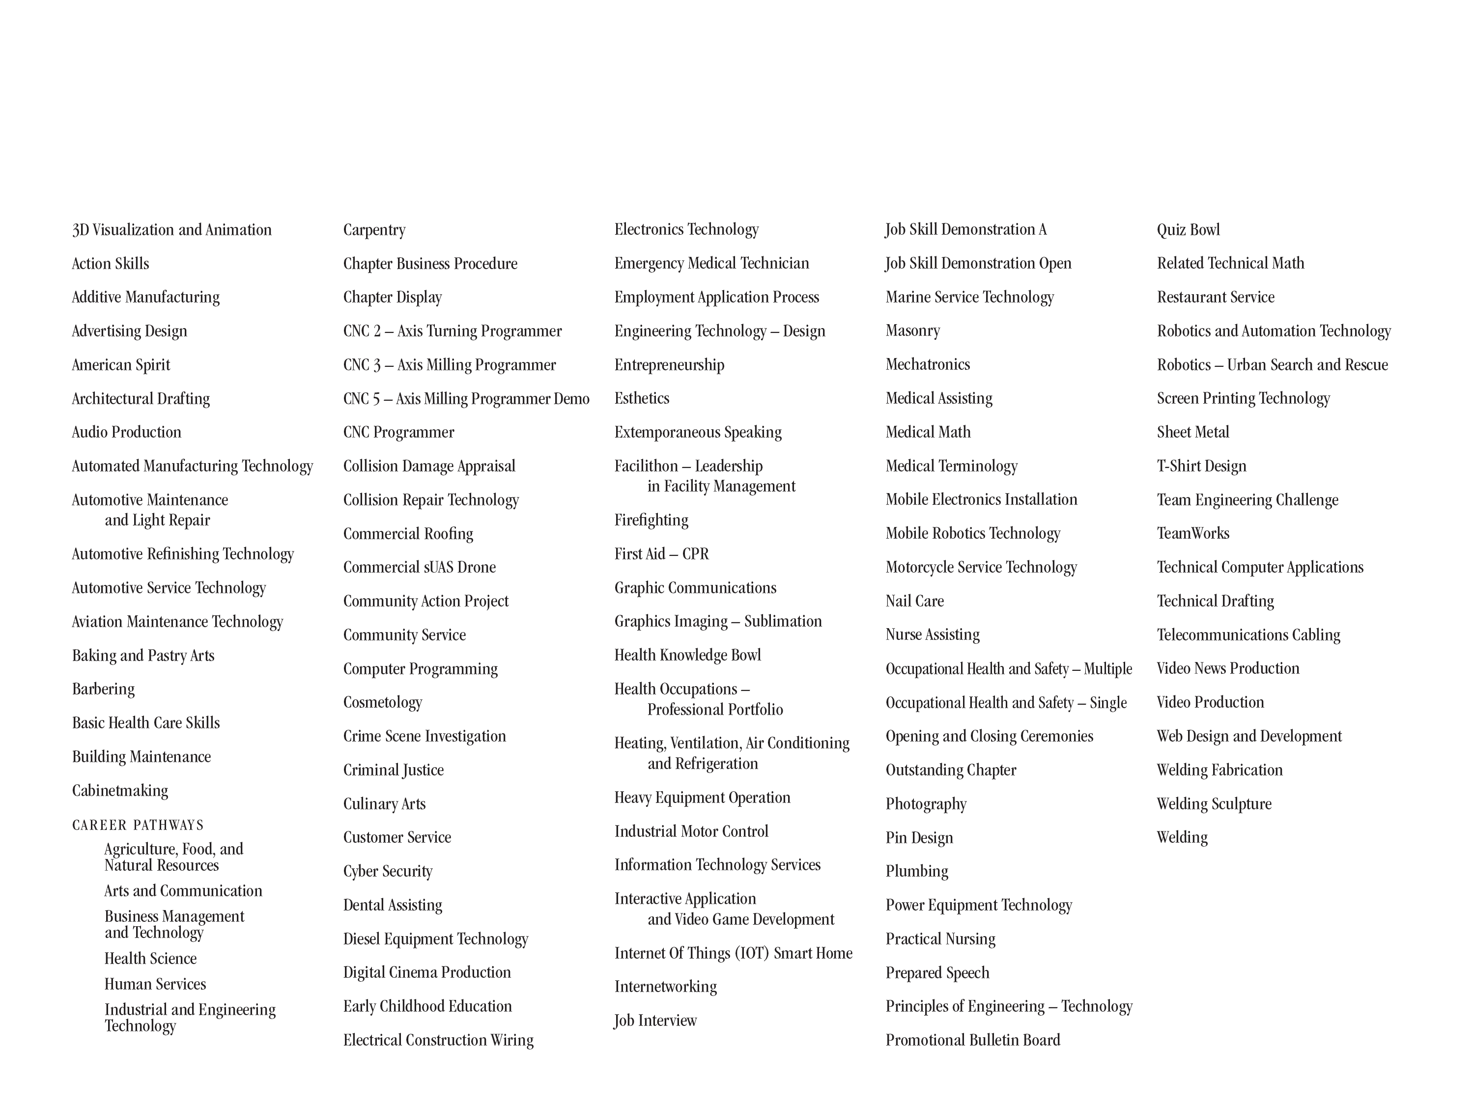

SkillsUSA Competitions (2025)
Total National Competitions: 114, Demonstration: 3

