Slide 2
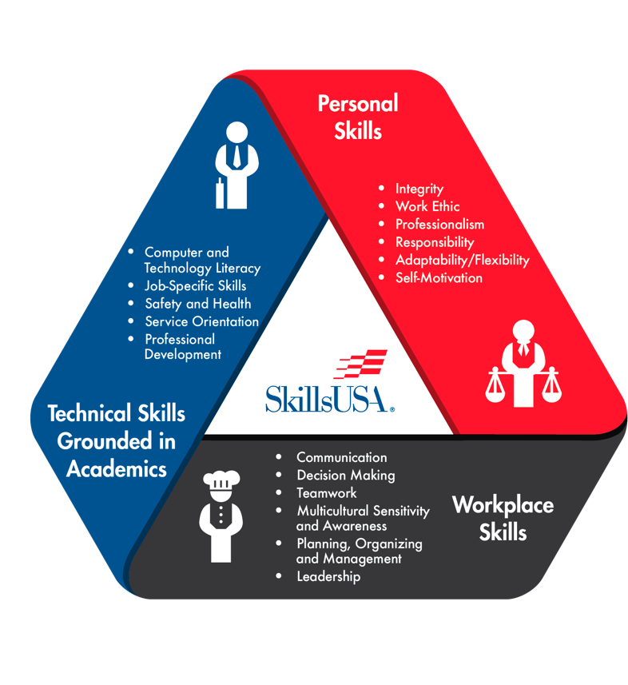
SKILLSUSA FRAMEWORK

Slide 3
PHASES OF CEP
The Challenge
Teaching the SkillsUSA Framework
Teaching and Assessing Needs of the Members
Identifying the Targeted Essential Element
Review Last Year’s Program of Work
Develop a Program of Work for the Current Year
Write SMART Goals for Chapter and POW Activities
Develop and Implement Project Management Plan for each POW Activity
Evaluate Chapter and POW Activity Goal Achievement
Celebrate Success

Slide 4
PHASE 1
THE CHALLENGE
Employers today are calling for more emphasis on career readiness skills in addition to applied academics and technical skills.
Top career readiness skills employers are looking for in 2019 are:
Communication
Leadership
Teamwork
Self-motivation
Responsibility
Integrity
Decision Marking
Problem Solving
According to TechnoSmarts and The Balance Career

Slide 5
PHASE 2
TEACHING THE SKILLSUSA FRAMEWORK

Slide 6
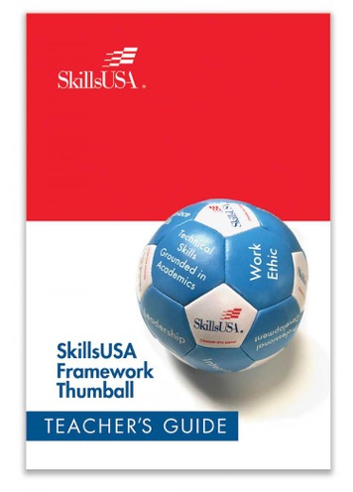
PHASE 2
TEACHING THE SKILLSUSA FRAMEWORK

Slide 7
PHASE 2
TEACHING THE SKILLSUSA FRAMEWORK
Jot down key bullet points to share that you as chapter would want to share with chapter members.
Identify an activity to use to engage chapter members
Identify an activity to help chapter members understand the 17 Essential Elements

Slide 8
PHASE 3
TEACHING AND ASSESSING THE NEEDS OF MEMBERS
What will your chapter officers gain from teaching their peers about the SkillsUSA Framework and Essential Elements?

Slide 9
PHASE 3
TEACHING AND ASSESSING THE NEEDS OF MEMBERS
Essential Element Assessment
Complete each question
Add scores from each essential element

Slide 10
PHASE 4
IDENTIFY THE TARGETED ESSENTIAL ELEMENTS
Essential Element Assessment
Add all chapter members scores together
Identify one target Essential Element within each component of the SkillsUSA Framework.

Slide 11
PHASE 5
REVIEW LAST YEARS PROGRAM OF WORK
Activity Evaluation:
Is the activity expected by our school?
Is the activity expected by our community?
Did the members enjoy the activity?
Assign Essential Element to activity based on needs assessment

Slide 12
PHASE 6
DEVELOP A PROGRAM OF WORK FOR THE CURRENT YEAR
Brainstorm one potential chapter activities from which participants can develop each targeted Essential Element from the student survey results
Create a budget
Develop a presentation to share

Slide 13
PROGRAM OF WORK
Professional Development
Employability
Community Service
Ways and Means
Championships
Public Relations
Social Activities

Slide 14
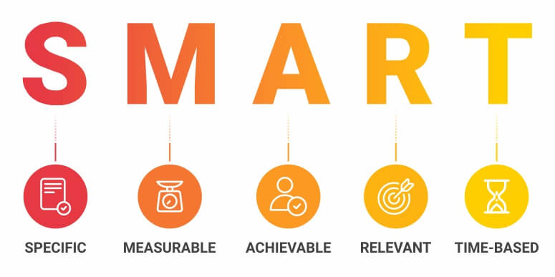
PHASE 7
WRITE SMART GOALS FOR CHAPTER AND POW ACTIVITIES

Slide 15
PHASE 7
WRITE SMART GOALS FOR CHAPTER AND POW ACTIVITIES
Essential Element Outcome Goal
100% of the students who participate in the Christmas Tree sales fundraiser will demonstrate 3 customer service skills as outlined the activity handbook and assessed by a peer review by the end of the sale period, Dec. 23, 2019.

Slide 16
PHASE 7
WRITE SMART GOALS FOR CHAPTER AND POW ACTIVITIES
Activity Outcome Goal
100 community members will attend the Veterans Appreciation breakfast on Nov. 11, 2019.

Slide 17
PHASE 8
DEVELOP AND IMPLEMENT PROJECT MANAGEMENT PLAN FOR EACH POW ACTIVITY
Plan of Action
Task to be completed
Timeline
Who is responsible
Resources
Budget
***Integrate the Essential Elements into the Plan of Action***

Slide 18
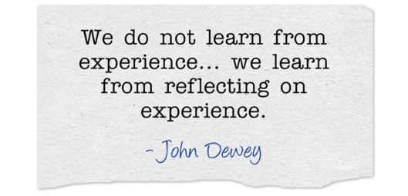
PHASE 9
EVALUATE CHAPTER AND POW ACTIVITY GOAL ACHIEVEMENT

Slide 19
PHASE 9
EVALUATE CHAPTER AND POW ACTIVITY GOAL ACHIEVEMENT
Evaluate the SMART Goals
Evaluate the Impact:
Opportunities for members to develop and demonstrate the targeted Essential Element
Public relations impact
Budget impact
What worked/Needs improvement

Slide 20
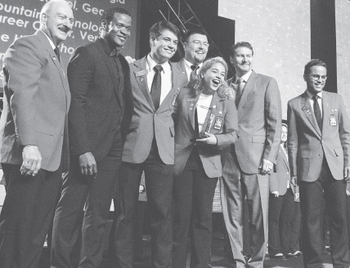
PHASE 10
CELEBRATE SUCCESSS

Slide 23
PARTNERS

Slide 24
CHAPTER CEP GOAL
Write one SMART goal around the Chapter Excellence Program (CEP) for this year.

Slide 25
Thank You!

